Slide 1
Our Universe
Chapter 35

Slide 2
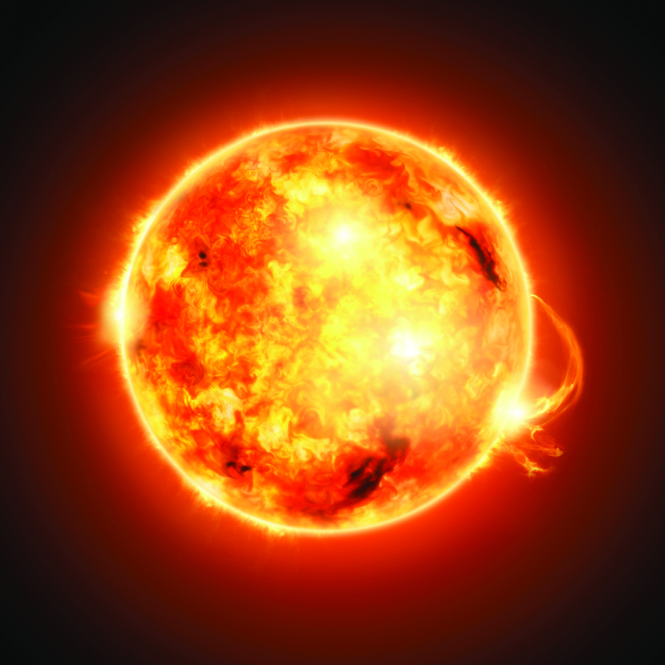
Stars
A star is a very big ball of burning gas.
Stars are not star shaped – they are spherical like a ball.
Stars give off huge amounts of light and heat.
SAMPLE

Slide 3
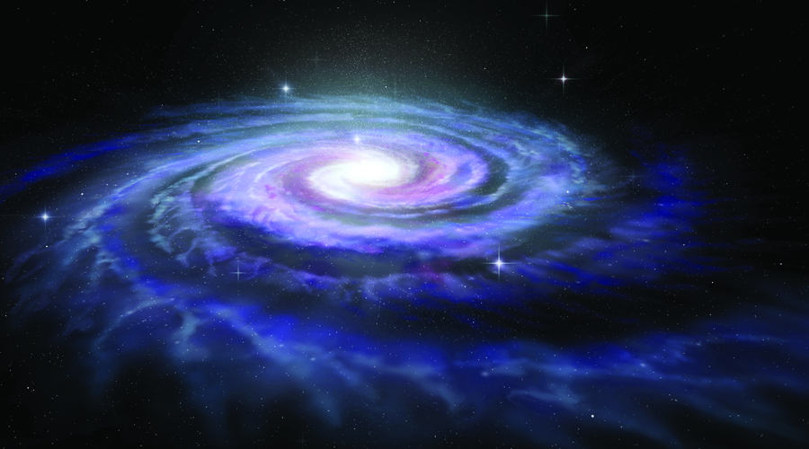
Galaxies
A typical galaxy is a collection of many millions of stars.
Galaxies can be different shapes but most galaxies are spiral.
Our galaxy is called the Milky Way. The Milky Way is a typical spiral galaxy.
SAMPLE

Slide 4
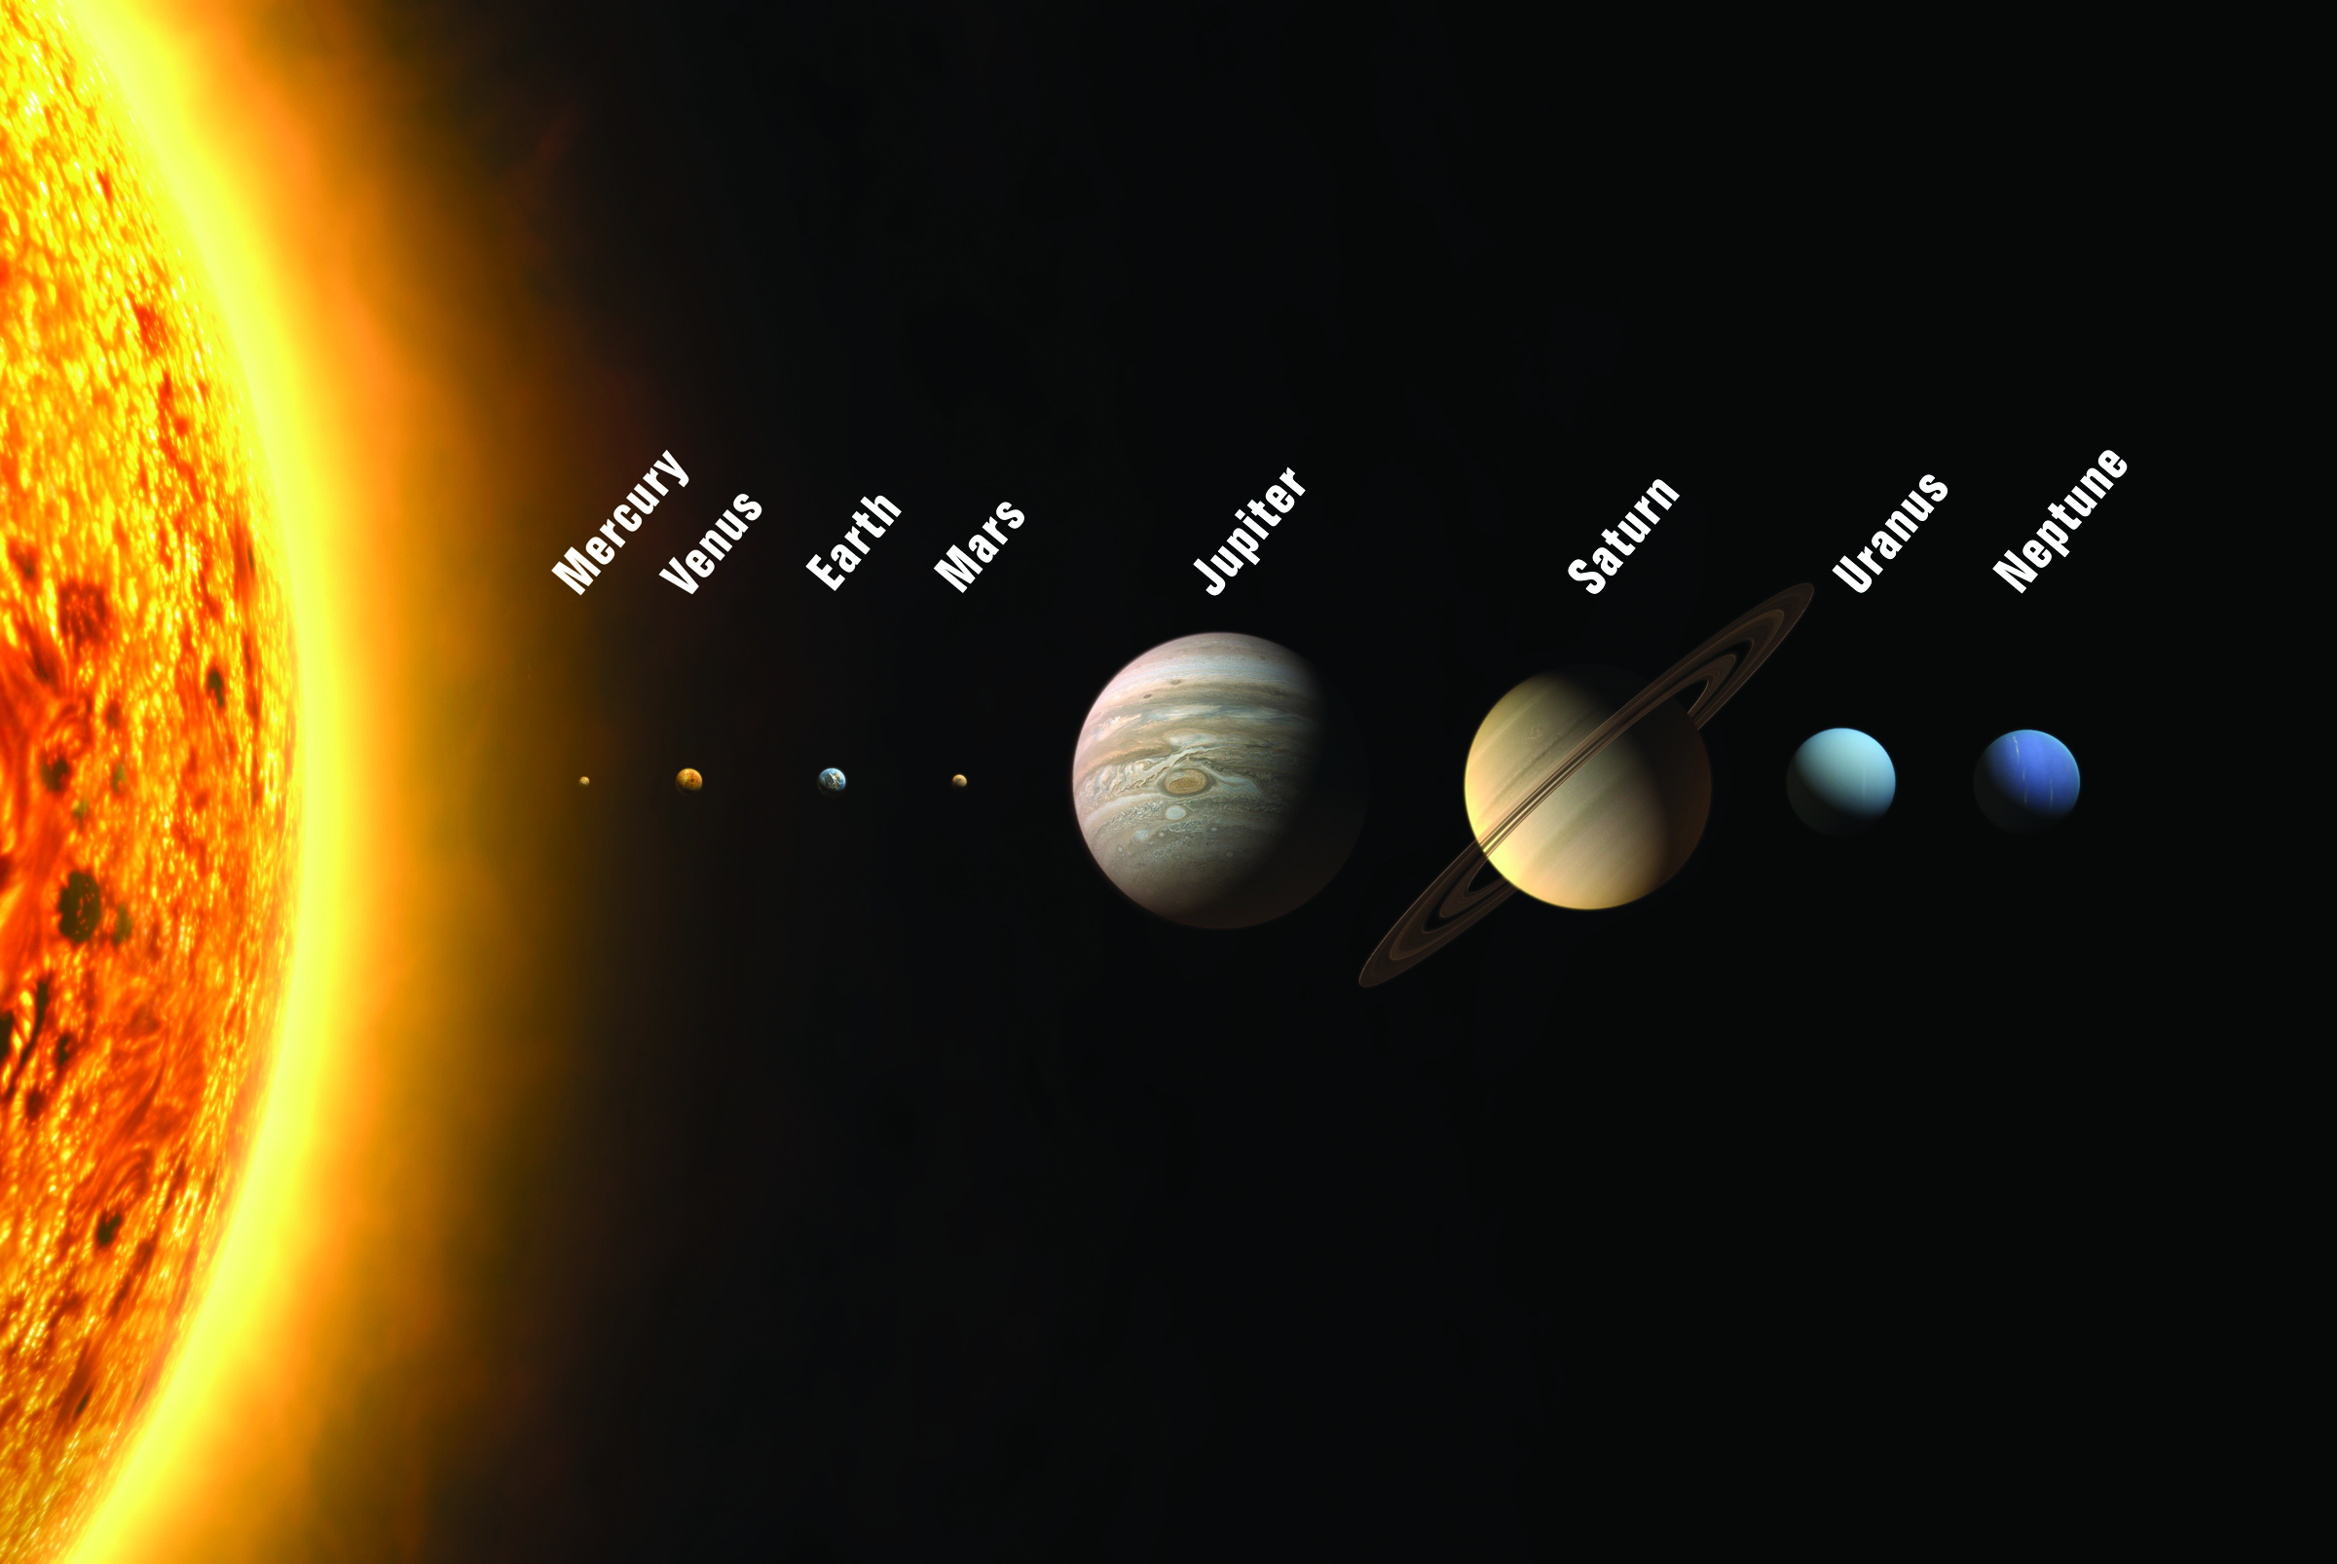
Solar Systems
SAMPLE
A solar system is made up of a star and the objects that move around it. Our solar system is made up of our sun and eight planets as well as moons, asteroids, comets, gas and dust.

Slide 5
Planets of Our Solar System
Inner Rocky Planets
Outer Gas Planets
Mercury
Venus
Earth
Mars
Jupiter
Saturn
Uranus
Neptune
SAMPLE

Slide 6
Dwarf Planets
Dwarf planets are objects that are similar to planets.
However, they are not planets because they have not cleared their own orbit.
To be classified as a planet, a space object has to be big enough to pull in smaller space objects with its own gravity.
Pluto is a dwarf planet.

Slide 7
Satellites & Moons
A satellite is an object that orbits a larger object or planet.
A moon is a naturally occurring satellite.
Earth has only one moon. It does not have a special name and is usually just called ‘the moon’.
SAMPLE

Slide 8
Asteroids
SAMPLE
An asteroid is a solid rocky object that orbits a star but is too small to be considered a planet .

Slide 9
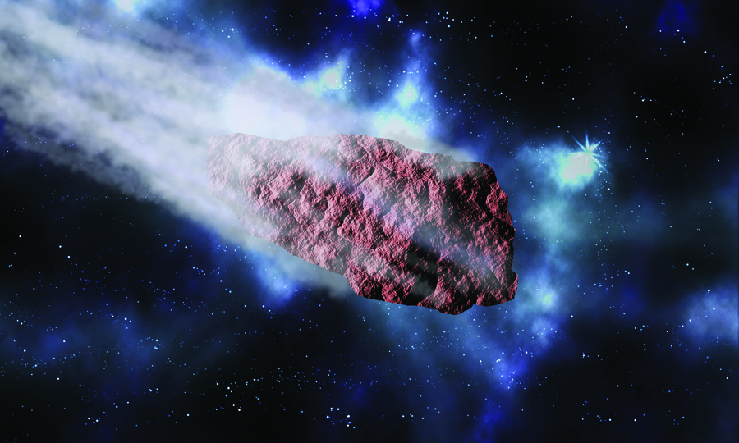
Comets
Comets are objects composed of frozen gases, ice, rock and dust.
Comets orbit the sun.
Comets can form a tail of dust and gases that may stretch for millions of kilometres.

Slide 10
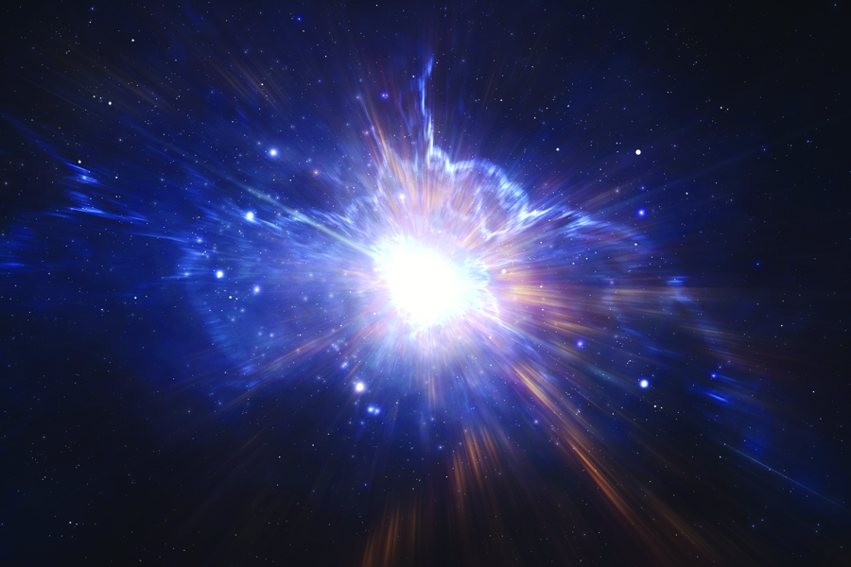
The Origins of Our Universe
SAMPLE
Most scientists think that the universe began with a
Big Bang over 13 billion years ago.

Slide 11
The Big Bang Theory
Astronomers have observed that other galaxies are moving away from ours at great speed.
Based on these observations, astronomers concluded that the universe is expanding.
They then developed a theory about how the universe began. This theory is called the Big Bang theory.
Before the Big Bang, the entire universe was compressed into a tiny, hot, dense mass. Then there was a huge expansion or inflation that allowed all of the universe’s matter and energy, as well as space and time, to form.

